Slide 1
RDA Cataloging Cooperative
Question 5 - How do I create an authorized access point?
Adam L. Schiff
Principal Cataloger
University of Washington Libraries
aschiff@uw.edu

Slide 2
Determining AAP for Works/Expressions
RDA Chapter 6
Determine the preferred title (6.2.2, 6.19.2)
Single work, or compilation of works? (6.2.2.10)
Determine the AAP (6.27)
Created by one entity? (6.27.1.2)
Collaborative work? (6.27.1.3)
Compilation of works by different entities? (6.27.1.4)
Adaptation or revision? (6.27.1.5)
Commentary or annotations added to another work? (6.27.1.6)
Creator(s) uncertain or unknown? (6.27.1.8)
Make additions to access point to distinguish it from others (6.27.1.9):
Same or similar but another work
Represents a person, family, corporate body, or place
Legal works (6.29.1)
Expression of work? (6.27.3, 6.29.2)
Notes:
I’m going to focus my presentation on authorized access points for works and expressions, with a little bit to say on persons and corporate bodies. This slide is sort of an outline to how one might go about determining an AAP for a work or expression.

Slide 3
Preferred Title
Created after 1500? (6.2.2.4, 6.19.2.2)
Choose title in the original language by which the work has become known either through use in resources embodying the work or in reference sources
Created before 1501? (6.2.2.5, 6.19.2.2)
Choose title or form of title in the original language by which the work is identified in modern reference sources
Exceptions for Classical and Byzantine Greek works and Anonymous works written neither in Greek nor in a preferred script of the agency
Manuscripts (6.2.2.7)

Slide 4
Notes:
Preferred title: Negligence

Slide 5
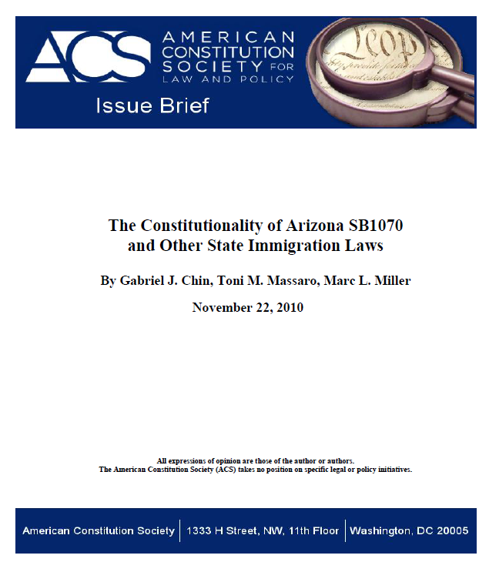
Notes:
Preferred title: Constitutionality of Arizona SB1070 and other state immigration laws

Slide 6
Notes:
Women and international human rights law

Slide 7
Preferred Title - Law
Modern laws, etc. (6.19.2.5)
Compilations: use Laws, etc. for complete or partial compilation of legislative enactments of a jurisdiction but not for a compilation of laws on a particular subject
If compilation of laws on a particular subject has a citation title, record that as the preferred title. Otherwise apply 6.2.2.3-6.2.2.8
LC-PCC PS for 6.19.2.5.1: Do not use Laws, etc. for a compilation limited to a type of law (e.g., civil or criminal code)
Single laws, etc. (in order of preference):
a) the official short title or citation title
b) an unofficial short title or citation title used in legal literature c) the official title of the enactment
d) any other official designation (e.g., the number, date)
Constitutions (LC-PCC PS for 6.19.2): Generally, use the word "constitution" (or its equivalent)
Ancient Laws, Certain Medieval Laws, Customary Laws, Etc. (6.19.2.6)
Treaties - see next session led by John Hostage

Slide 8
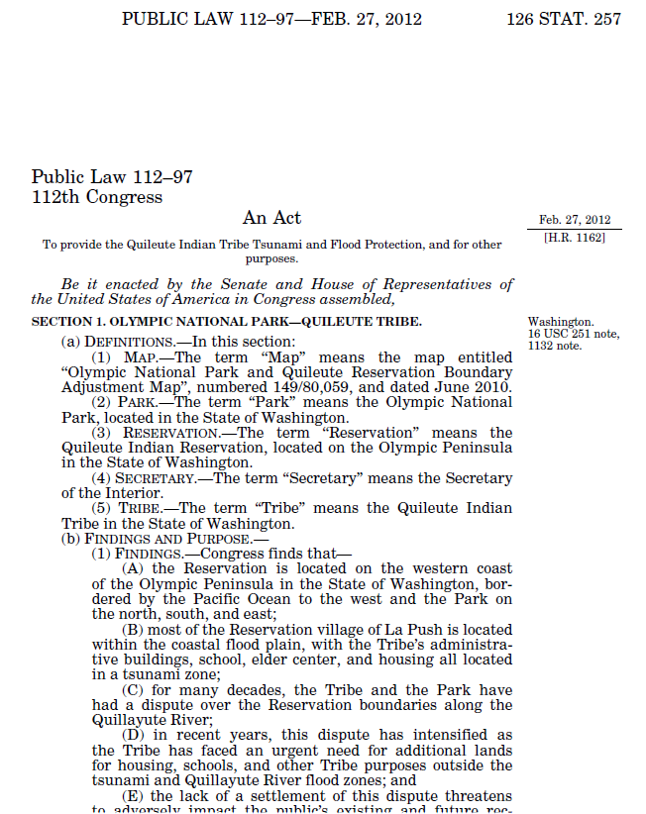
Notes:
What is the preferred title of this work?
No short title or citation title found. Preferred title is official title: Act to Provide the Quileute Indian Tribe Tsunami and Flood Protection, and for Other Purposes. Public Law 112-97 is a variant title.

Slide 9
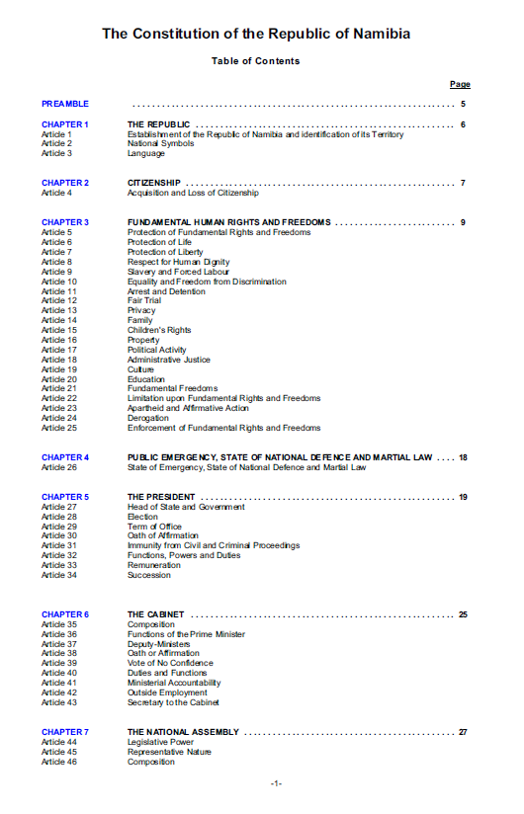
Notes:
Preferred title: Constitution [LC-PCC PS for 6.19.2: generally use the word “constitution” or its equivalent]

Slide 10
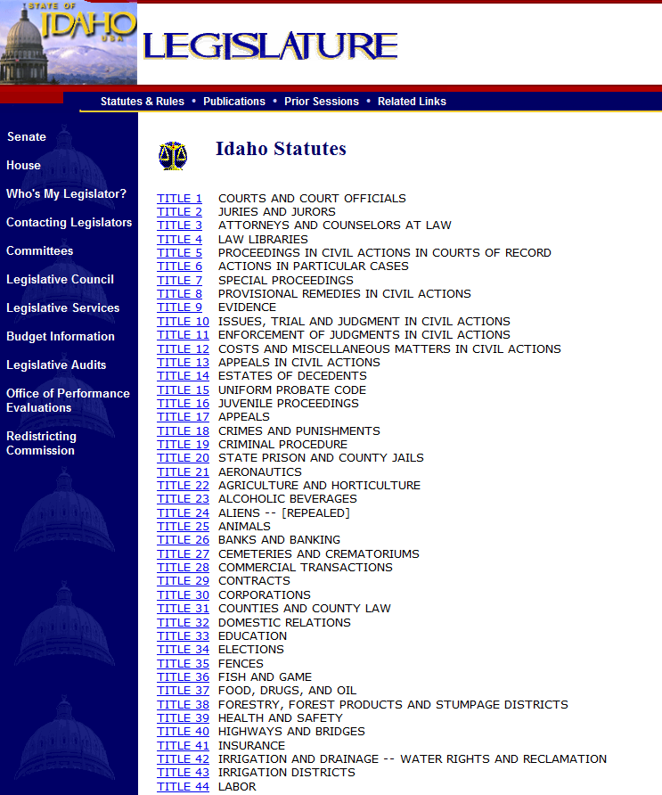
Notes:
Idaho Statutes and Constitutions are updated to the web July 1 following the legislative session.
Idaho Statutes and Constitutions are current through the 2012 Legislative Session.
Preferred title: Laws, etc.

Slide 11
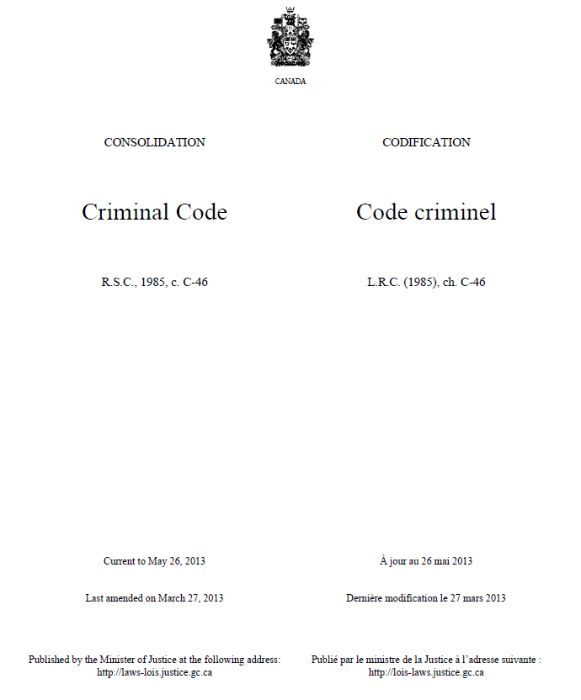
Notes:
Preferred title: Criminal code

Slide 12
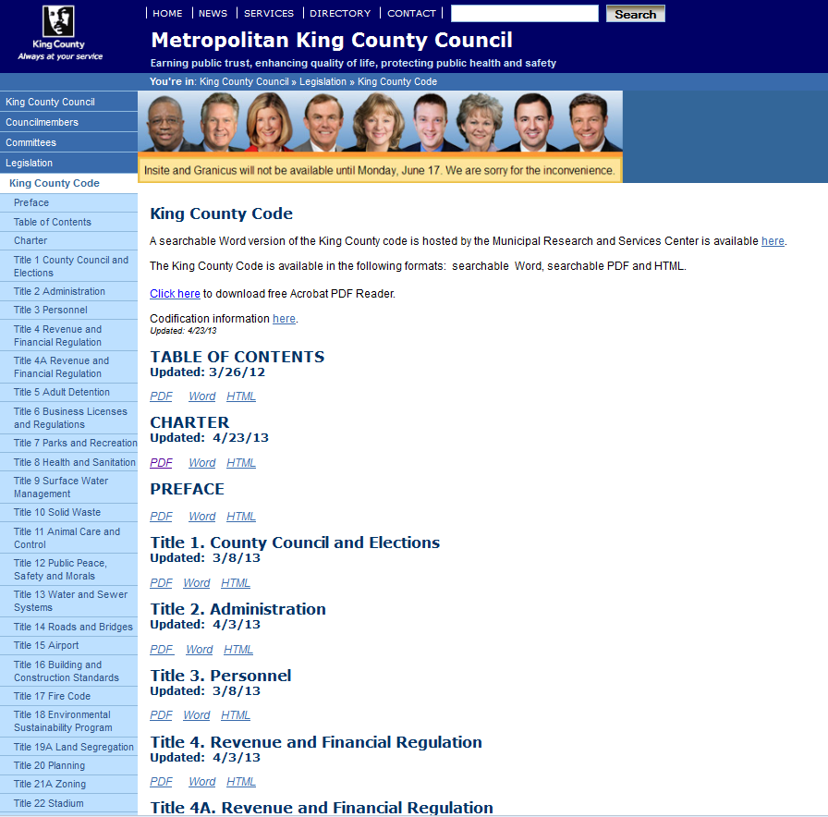
Notes:
Preferred title: Laws, etc.

Slide 13
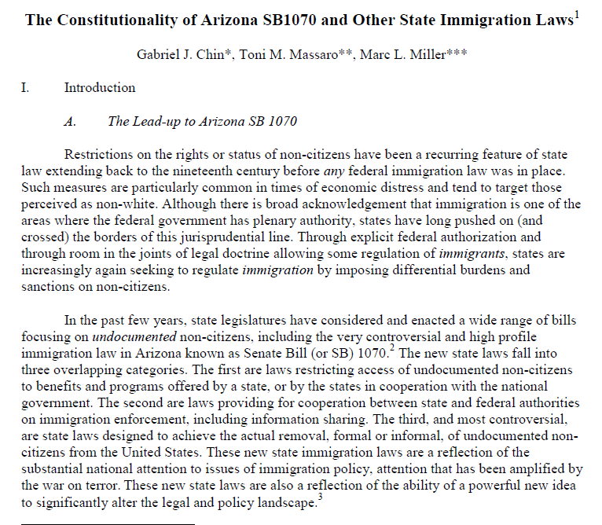
What is preferred title for the work that is the subject of this work? See also the next slide.

Slide 14
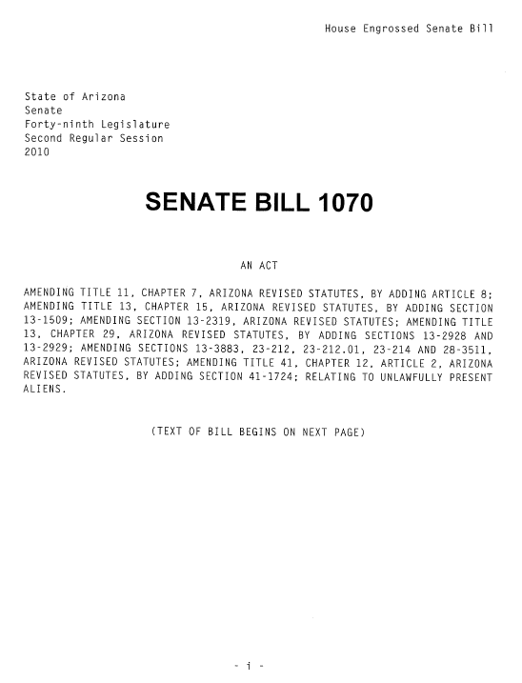
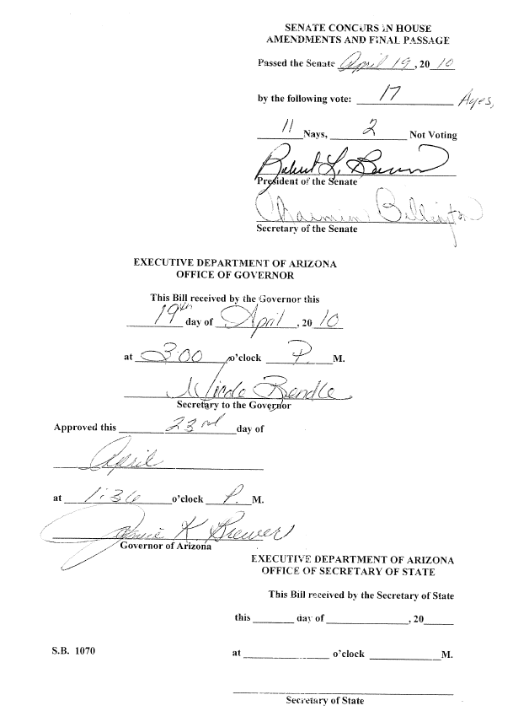
Notes:
Preferred title: Support Our Law Enforcement and Safe Neighborhoods Act. SB107 is a variant title.

Slide 15
Access Points for Works and Expressions
Works: 6.27.1
Created by one entity (6.27.1.2): combine AAP for entity + Preferred title
Collaborative works (6.27.1.3): combine AAP for entity with principal responsibility + Preferred title. Corporate creators trump other creators
Other exceptions: moving image and musical works, treaties
If two or more creators have principal responsibility: use first-named
If no principal responsibility indicated, use first-named
Compilations of works by different entities (6.27.1.4): use preferred title for the compilation
If no collective title for compilation, construct separate access points for each work in the compilation

Slide 16
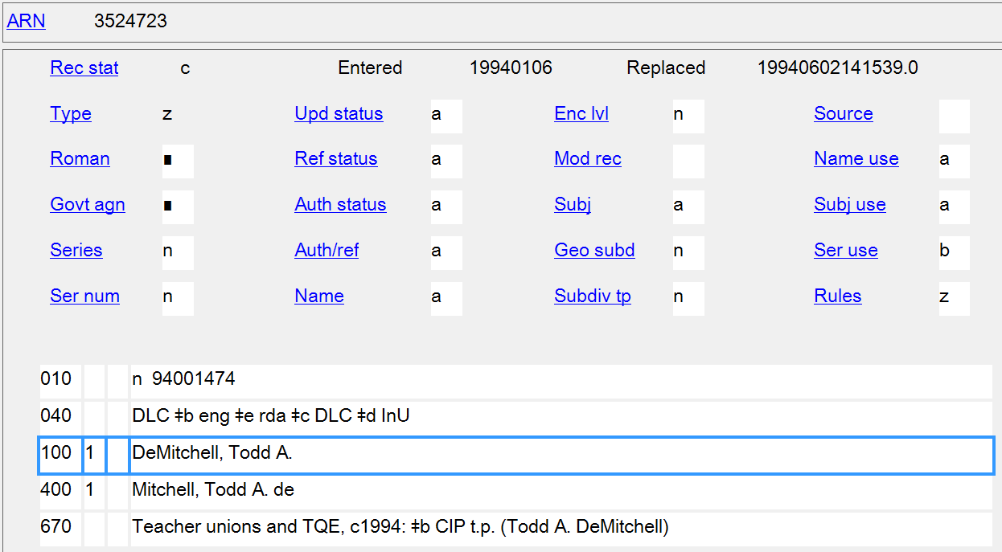
AAP for the work:
100 1_ DeMitchell, Todd A. $t Negligence

Slide 17
Authorized access points for creators:
100 1_ Markesinis, Basil, $d 1944-
100 1_ Fedtke, Jörg
AAP for the work:
100 1_ Markesinis, Basil, $d 1944- $t
Engaging with foreign law

Slide 18
AAP for the work:
130 _0 Women and international
human rights law

Slide 19
AAP for the work:
110 1_ Namibia. $t Constitution

Slide 20
Access Points for Works and Expressions
Works: 6.27.1
Existing work with added commentary, annotations, illustrative content, etc. (6.27.1.6):
If presented as the work of the entity responsible for the commentary, etc.: combine AAP for the entity responsible + Preferred title
If presented simply as an edition of the previously existing work, treat it as an expression of that work

Slide 21
AAP for the work:
100 1_ Ahmed, Mumtaz, $d 1965-
$t Azad Jammu and Kashmir
Interim Constitution Act, 1974,
with comprehensive &
exhaustive commentary and
historical documents

Slide 22
AAPs for the work and expressions:
110 1_ Switzerland. $t Bundesverfassung
(1874).
110 1_ Switzerland. $t Bundesverfassung
(1874). $l English
or if needed for more differentiation
110 1_ Switzerland. $t Bundesverfassung
(1874). $l English $s (Hughes)
Notes:
This is presented as an expression of a previously existing work, so it is not named using the access point for the translator/commentator.

Slide 23
Additions to Work Access Points (6.27.1.9)
Make additions to distinguish the access point for a work:
from one that is the same or similar but represents a different work
or
from one that represents a person, family, corporate body, or place.
Add one or more of the following:
form of work
date of work
place of origin of work
other distinguishing characteristic of work

Slide 24
245 00 Constitutional law / $c edited by Joel Wm. Friedman.
264 _1 Austin, Texas : $b Wolters Kluwer Law & Business ; $a New York : Aspen
Publishers, $c [2007]
490 1_ Friedman’s practice series
650 _0 Constitutional law $z United States $v Examinations, questions, etc.
245 00 Constitutional law / $c edited by Ian Loveland.
264 _1 Aldershot, Hants, England ; $a Brookfield, Vermont : $b Ashgate/
Dartmouth, $c [2000]
490 1_ The international library of essays in law and legal theory. Second series
650 _0 Constitutional law.
245 00 Constitutional law / $c edited by Mark V. Tushnet.
264 _1 New York, NY : $b New York University Press, $c 1992.
490 1_ The international library of essays in law and legal theory. Areas ; $v 9
500 "New York University Press reference collection."
650 _0 Constitutional law $z United States.
Notes:
Three works whose preferred titles are the same and whose authorized access points would be identical. An addition must be made to the authorized access points to distinguish the works.

Slide 25
130 0_ Constitutional law ( )
245 10 Constitutional law / $c edited by Joel Wm. Friedman.
Possibilities: (Examinations) (2007) (Austin, Tex.) (Friedman) (Friedman’s practice series)
130 0_ Constitutional law ( )
245 10 Constitutional law / $c edited by Ian Loveland.
Possibilities: (Essays : 2000) (Essays : Loveland) (2000) (Aldershot, England) (Loveland)
130 0_ Constitutional law ( )
245 10 Constitutional law / $c edited by Mark V. Tushnet.
Possibilities: (Essays : 1992) (Essays : Tushnet) (1992) (New York, N.Y.) (Tushnet)
Notes:
Three works whose preferred titles are the same and whose authorized access points would be identical. An addition must be made to the authorized access points to distinguish the works.

Slide 26
AACR2: 245 00 The Bar Association of San Francisco : ǂb an illustrated history from 1872 to 1924 / $c editor, J.O. Denny. 260 San Francisco : ǂb A. Wheeler, ǂc 1923.
RDA:
130 0_ Bar Association of San Francisco (History) 245 10 The Bar Association of San Francisco : ǂb an
illustrated history from 1872 to 1924 / ǂc editor, J.O.
Denny.
or perhaps (1923) (Denny) (San Francisco, Calif.)
(Illustrated history) (Arthur Wheeler)
Notes:
This illustrates the situation of a work whose access point would be identical to one that represents a person, family, corporate body, or place. RDA tells us to make additions to the work access point to distinguish the work. The choice is up to the cataloger and can be: form of work; date of work; place of origin of work; and/or another distinguishing characteristic of the work.

Slide 27
Additions to Access Points for Laws, Etc. (6.29.1.32)
If access points for laws, etc. are same or similar, add year of promulgation
110 1_ Nigeria. $t Evidence Act (1945)
110 1_ Nigeria. $t Evidence Act (1990)
110 1_ Virginia. $t Constitution (1776)
110 1_ Virginia. $t Constitution (1830)
110 1_ Virginia. $t Constitution (1851)
110 1_ Virginia. $t Constitution (1869)
110 1_ Virginia. $t Constitution (1902)
110 1_ Virginia. $t Constitution (1971)

Slide 28
Additions to Access Points for Laws, Etc. (6.29.1.32)
LC-PCC PS for 6.29.1.32 has additional instructions for on what to add to Laws, etc. for
Compilations of Laws Other Than Those of U.S. States
Session Laws of the U.S. States
Codes of the U.S. States
Notes:
I’m not going to go in to these instructions, because you all probably know them better than me (and we’re short on time).

Slide 29
Expressions (6.27.3, 6.29.2)
Add to the authorized access point representing the work one or more of the following
content type
date of the expression
language of the expression
another distinguishing characteristic of the expression

Slide 30
110 1_ Latvia.
245 10 Latvijas Republikas satversme = $b
Constitution of the Republic of Latvia =
Konstitu︠t︡si︠i︡a Latviĭskoĭ respubliki.
710 12 $i Contains (work): $a Latvia. $t Satversme.
710 12 $i Contains (expression): $a Latvia. $t
Satversme. $l English.
710 12 $i Contains (expression): $a Latvia. $t
Satversme. $l Russian.

Slide 31
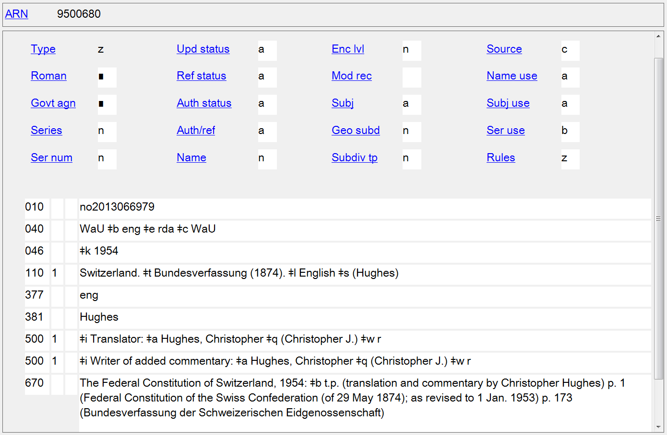
Notes:
Expression authority record for the Hughes translation into English of the Swiss Federal Constitution of 1874.
Note also the kinds of relationships that can now be encoded in work authority records, as shown here by the 500 fields relating a person to this expression. The next slide illustrates relationships between works.

Slide 32
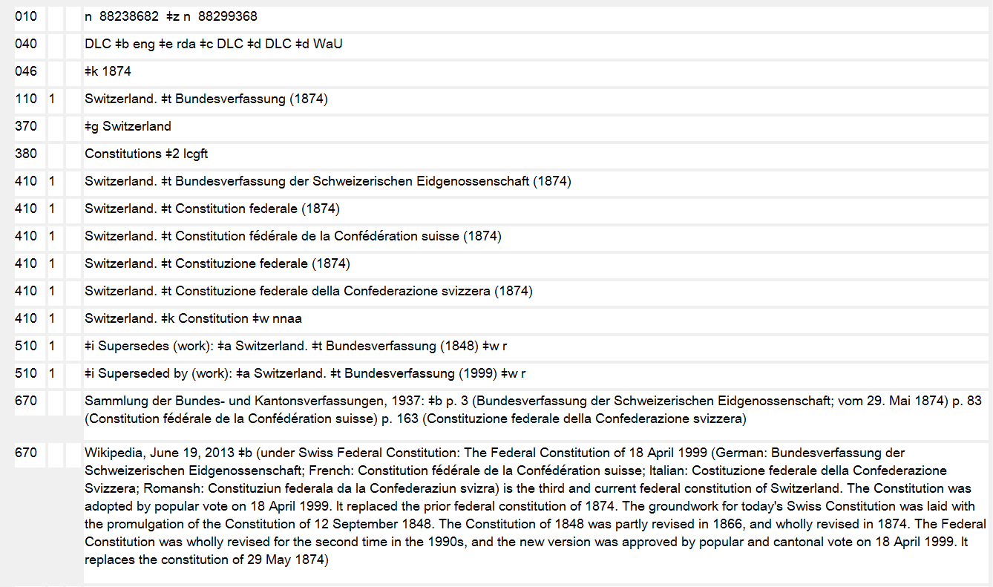

Slide 33
Other Noteworthy Access Point Changes
Personal Names
Profession/Occupation
Terms indicative of rank, honour or office, if the terms appear with the name (new 9.4.1.9, 9.19.1.6)
Wood, John, $c Captain
Appleby, Robert, $c Sir
Brown, Timothy, $c Reverend
Other designation (new 9.6.1.9, 9.19.1.7)
Nichols, Chris $c (Of the North Oxford Association)
Lang, John $c (Brother of Andrew Lang)
Budd, Henry $c (Cree Indian)
Yaśodharā $c (Wife of Gautama Buddha)
Independent Burgess $c (Of Nottingham)
Notes:
9.6.1.9 If neither a date of birth nor a date of death associated with the person, nor a fuller form of name, nor a period of activity, nor a profession or occupation, nor a term of rank, honour or office, is sufficient or appropriate for distinguishing between two or more persons, record an appropriate designation in the language preferred by the agency creating the data.
9.19.1.7 If none of the additions covered under 9.19.1.3–9.19.1.6 is sufficient or appropriate for distinguishing between two or more persons, add an appropriate designation (see 9.6.1.9).

Slide 34
Other Noteworthy Access Point Changes
Conferences, Congresses, Fairs, Festivals, etc.
Frequency included in preferred name of conferences, congresses, etc.
110 2_ Association of American Law Schools. $b Annual Meeting
Year of convocation omitted from preferred name of exhibitions, fairs, festivals, etc. and added in qualifier in authorized access points them (11.13.1.8)
111 2_ ADBIS '99 $d (1999 : $c Maribor, Slovenia) becomes
111 2_ ADBIS (Conference) $n (3rd : $d 1999 : $c Maribor, Slovenia)
Location added in qualifier in authorized access points even if it is also in the preferred name (11.13.1.8)
Notes:
9.6.1.9 If neither a date of birth nor a date of death associated with the person, nor a fuller form of name, nor a period of activity, nor a profession or occupation, nor a term of rank, honour or office, is sufficient or appropriate for distinguishing between two or more persons, record an appropriate designation in the language preferred by the agency creating the data.
9.19.1.7 If none of the additions covered under 9.19.1.3–9.19.1.6 is sufficient or appropriate for distinguishing between two or more persons, add an appropriate designation (see 9.6.1.9).

Slide 35
Named Conferences
LCRI 21.1B1: the phrase must include a word that connotes a meeting: "symposium," "conference," "workshop," "colloquium," etc.
11.7.1.4 If the preferred name for the body does not convey the idea of a corporate body, record a suitable designation in the language preferred by the agency creating the data.
Authorized access points in RDA that are not valid headings in AACR2:
111 2_ Nature of Law: Contemporary Perspectives (Conference) $d (2011 : $c McMaster University)
111 2_ Poverty and the International Economic Law System: Duties to the World's Poor (Conference) $d (2011 : $c University of Basel)
111 2_ Weather Radar and Hydrology (Symposium) $d (2011 : $c Exeter, England)
Notes:
AACR2 21.1B1. A corporate body is an organization or a group of persons that is identified by a particular name and that acts, or may act, as an entity. Consider a corporate body to have a name if the words referring to it are a specific appellation rather than a general description. Consider a body to have a name if, in a script and language using capital letters for proper names, the initial letters of the words referring to it are consistently capitalized, and/or if, in a language using articles, the words are always associated with a definite article. Typical examples of corporate bodies are associations, institutions, business firms, nonprofit enterprises, governments, government agencies, projects and programmes, religious bodies, local church groups identified by the name of the church, and conferences. Conferences are meetings of individuals or representatives of various bodies for the purpose of discussing and/or acting on topics of common interest, or meetings of representatives of a corporate body that constitute its legislative or governing body.
LCRI 21.1B1. When determining whether a conference has a name, cases arise that exhibit conflicting evidence insofar as two of the criteria in the definition of a corporate body are concerned: capitalization and the definite article. When the phrase is in a language that normally capitalizes each word of a name, even in running text, consider a capitalized phrase a name even if it is preceded by an indefinite article. (This statement cannot apply to other languages.)
Another important point to bear in mind when deciding whether a phrase is a name is that the phrase must include a word that connotes a meeting: "symposium," "conference," "workshop," "colloquium," etc. Note: Some notable sequential conferences that lack such a term are exceptionally considered to be named, e.g., Darmstädter Gespräch. In addition, phrases that combine acronyms or initialisms with the abbreviated or full form of the year are also considered to be named.
RDA 11.2.1.1 A name of the corporate body is a word, character, or group of words and/or characters by which a corporate body is known.
11.2.2.1 The preferred name for the corporate body is the name or form of name chosen as the basis for the authorized access point representing that body.
11.7.1.1 Other designation associated with the corporate body is a word, phrase, or abbreviation indicating incorporation or legal status of a corporate body, or any term serving to differentiate the body from other corporate bodies, persons, etc.
11.7.1.4 If the preferred name for the body does not convey the idea of a corporate body, record a suitable designation in the language preferred by the agency creating the data.
LCRI 21.1B1 was not carried over into the LC Policy Statements. Therefore a conference in RDA does not have to have a word denoting a meeting in its preferred name. However, a qualifier will need to be added to names of conferences that do not convey the idea of a conference.

Slide 36
Notes:
Image source: http://rlv.zcache.com/stripes_legal_scales_thank_you_card_navy_blue-p137832889934288565envcr_400.jpg

